Slide 1
Data Science (Analytics): Industry Landscape & Relevance

Slide 2
Ground Rules

Slide 3

The 3 W Framework
Part 1
Setting the Context
(Why?)
Part 2
The India Analytics Landscape
(What?)
Part 3
Applications @ Work
(How?)
Part 4
Q & A
15 minutes
15 minutes
15 minutes
15 minutes

Slide 4
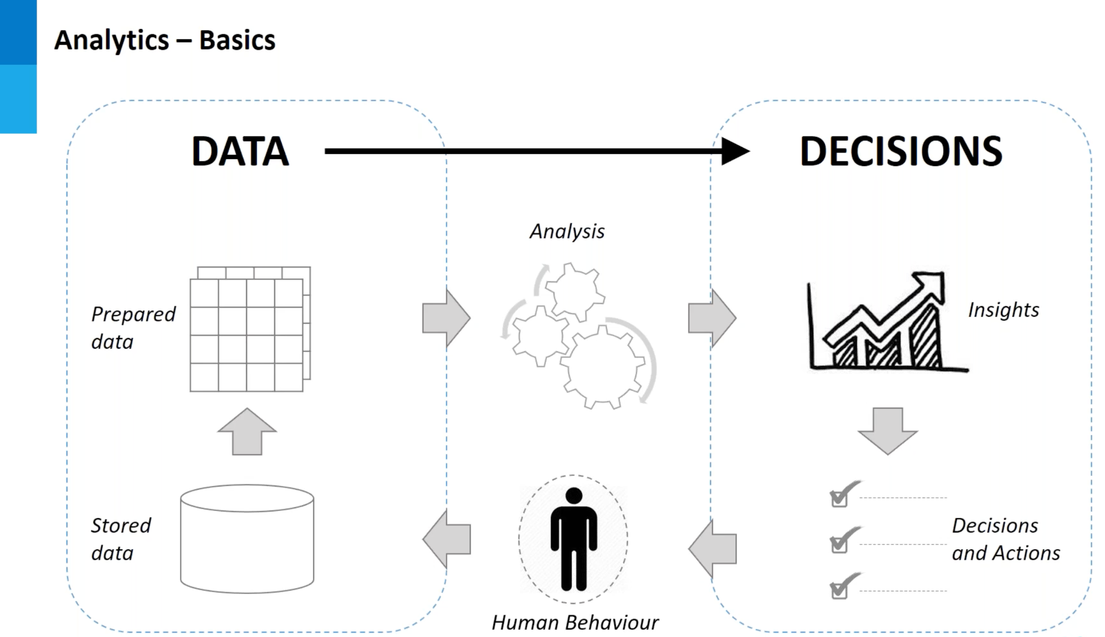

Slide 5
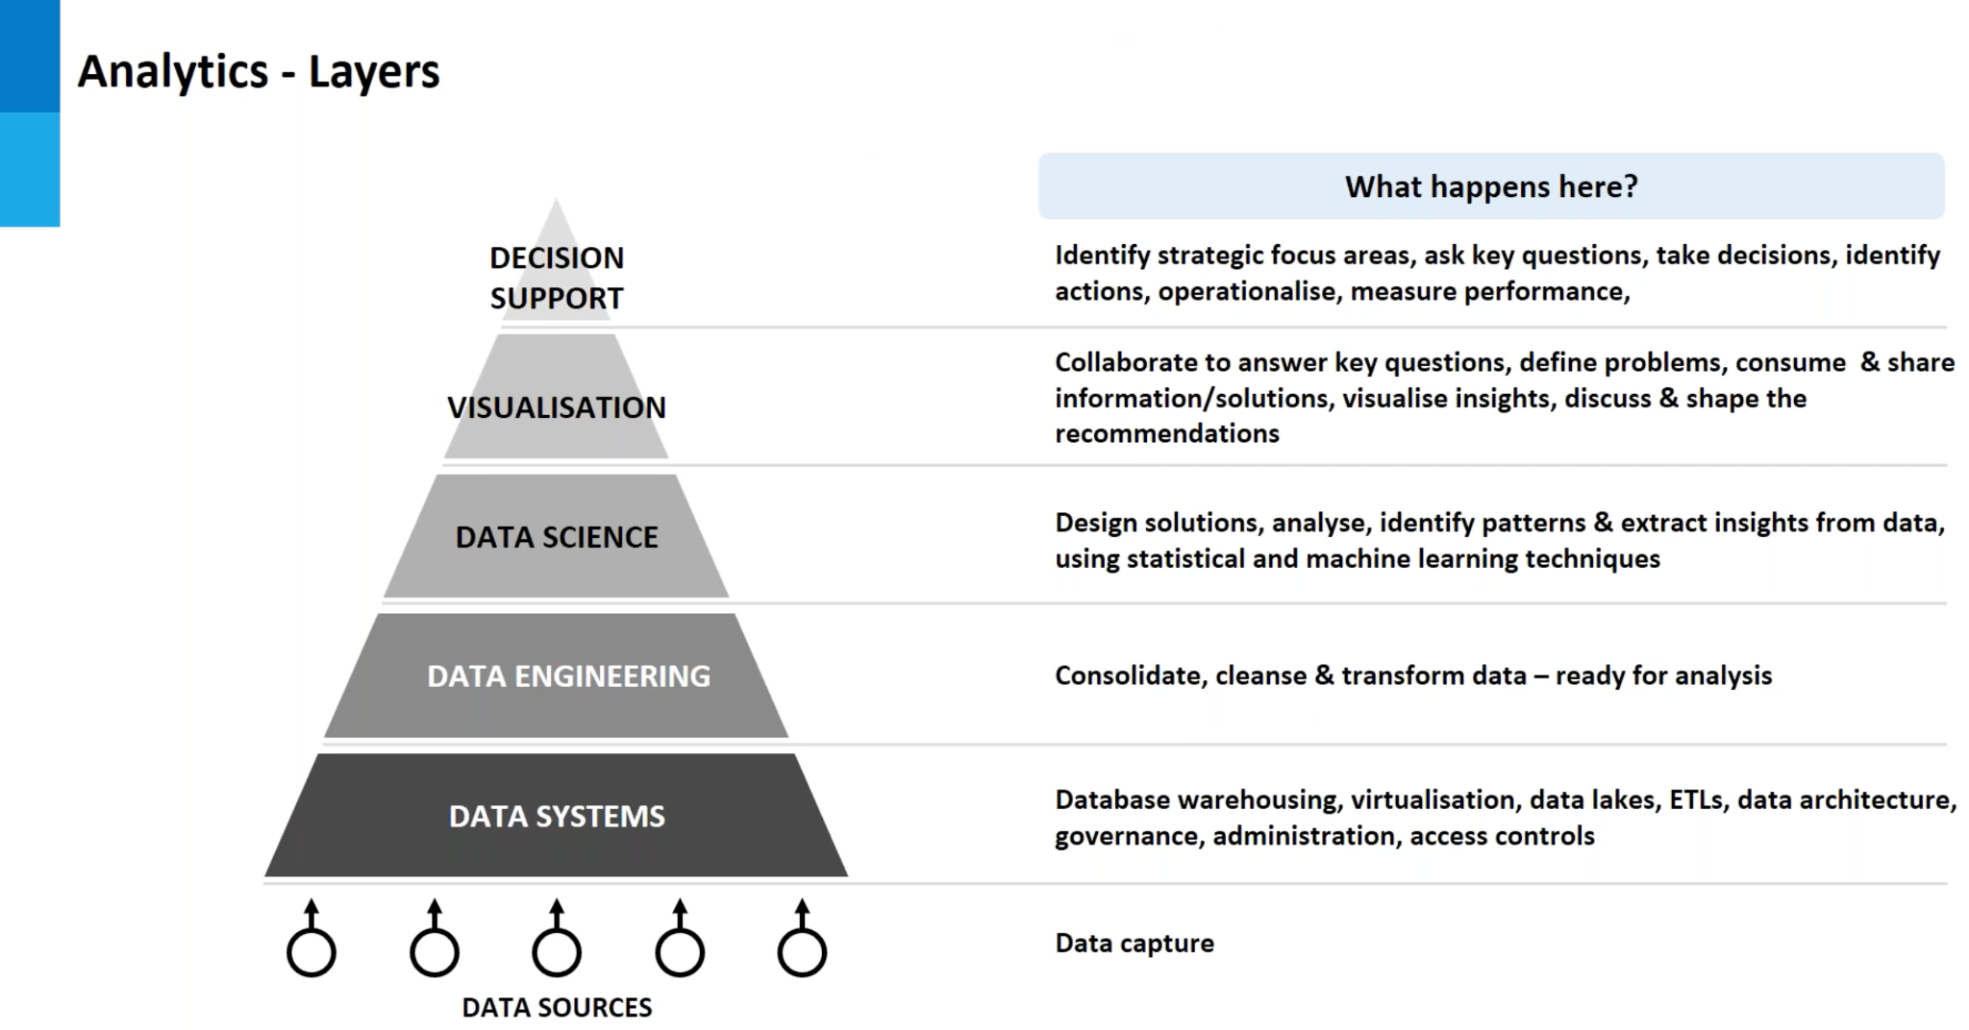

Slide 6
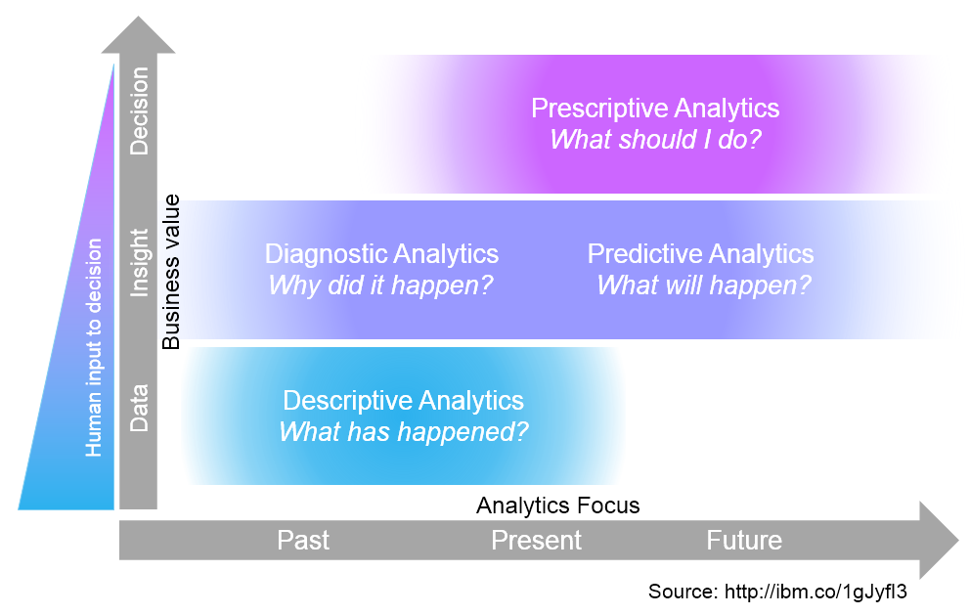
Value Propositions of Data Science
Complexity
4
Foresight
2
3
Insight
1
Hindsight

Slide 7
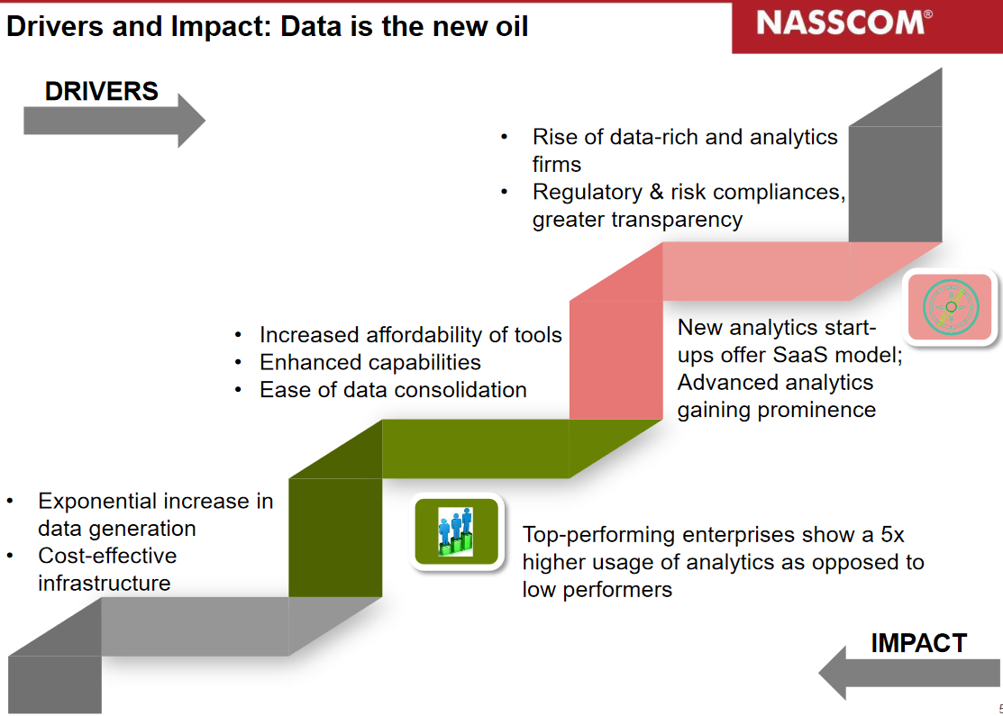
Value Propositions of Data Science
Technology & Compliance
Value

Slide 8
Part 2
The India Analytics Landscape
(What?)
Part 3
Applications @ Work
(How?)
Part 4
Q & A
15 minutes
15 minutes
15 minutes

Slide 9
The India Analytics Industry 2020
No longer restricted to IT, banking, & MNCs
Not specific to supporting business functions (customer facing)
Emerged as necessary capability across sectors
Transcends multiple organizational functions : RM procurement to production to customers
Firms investing capital (CAPEX or long-term) and operational resources (OPEX or day-to-day)
Enabler of sustainable competitive advantage

Slide 10
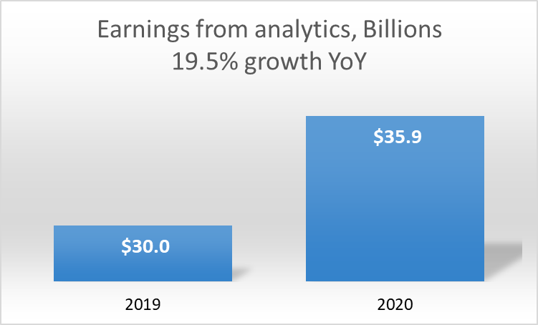
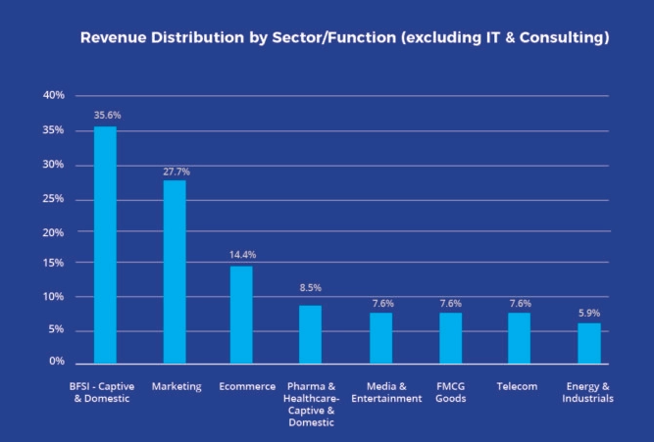
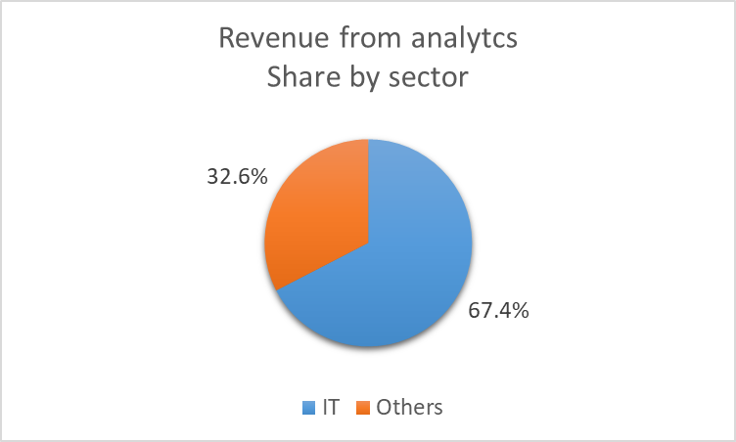
The India Analytics Industry 2020

Slide 11
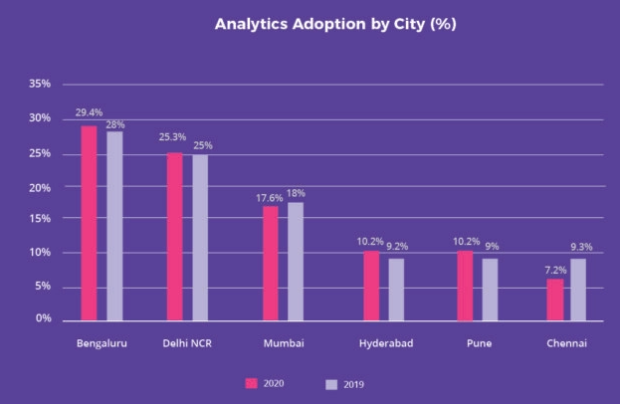
The India Analytics Industry 2020

Slide 12
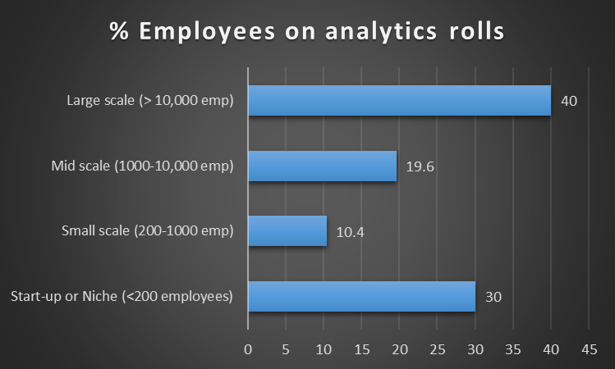
The India Analytics Industry 2020

Slide 13
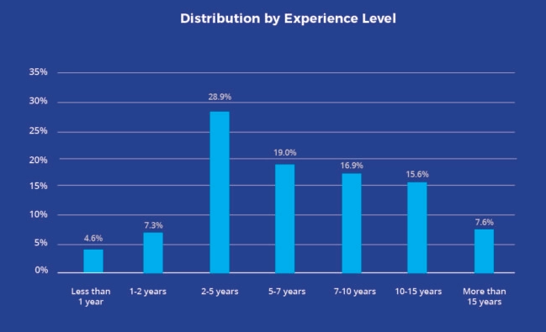
The India Analytics Industry 2020

Slide 14
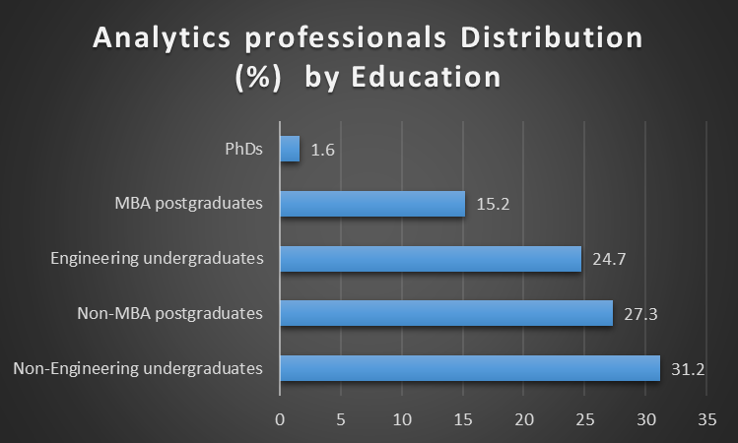
The India Analytics Industry 2020

Slide 15
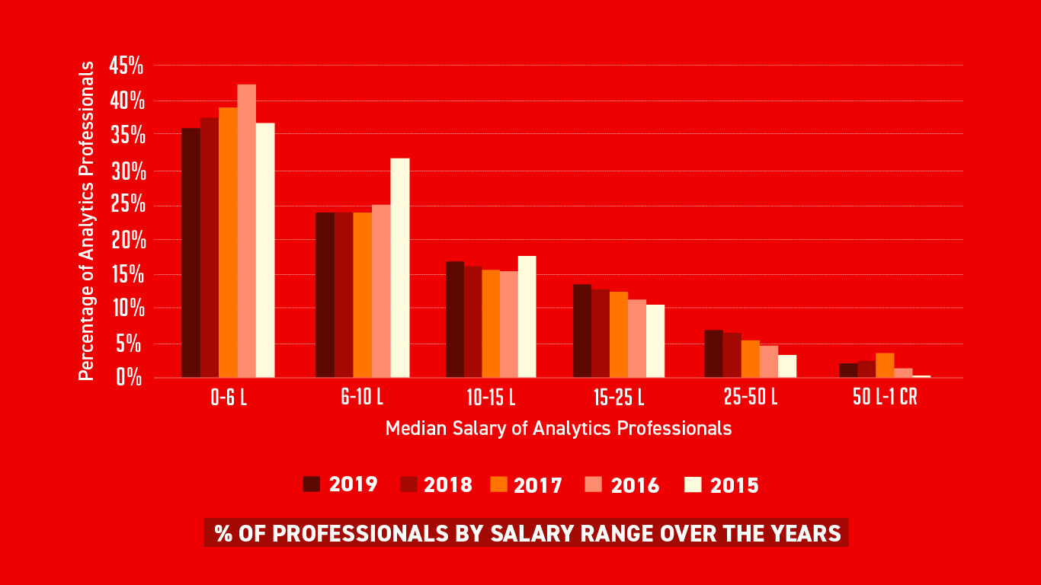
The India Analytics Industry 2019

Slide 16
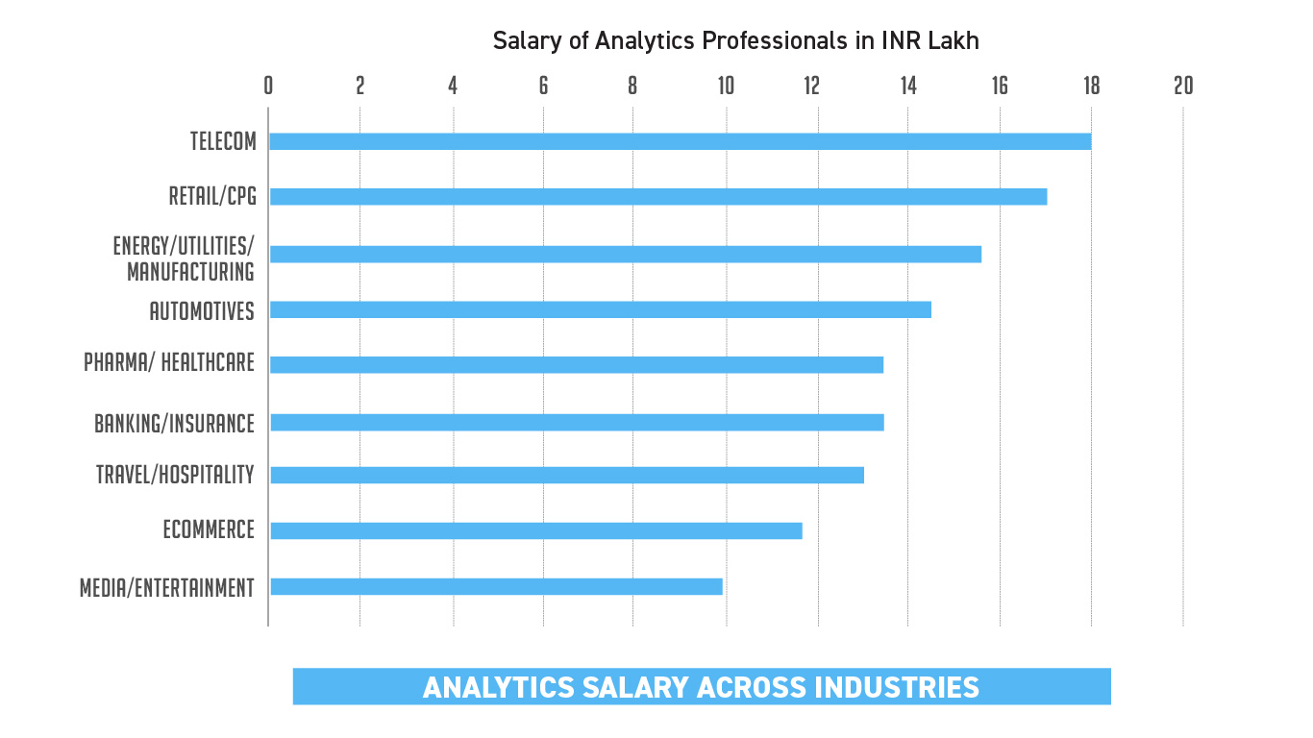
The India Analytics Industry 2019

Slide 17
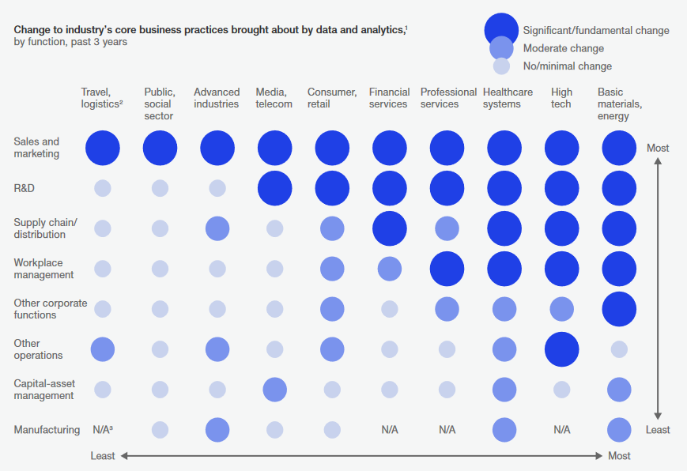
Analytics Impact by Function - 2018

Slide 18
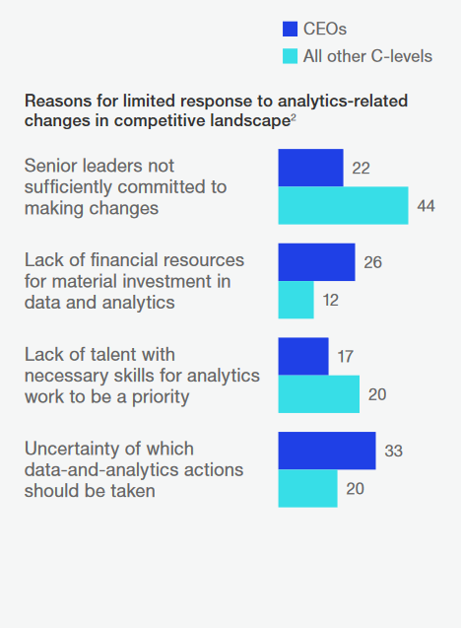
Firm Leadership Behind Analytics Adoption 2018
Behavioral
Operational
Operational
Strategic

Slide 19
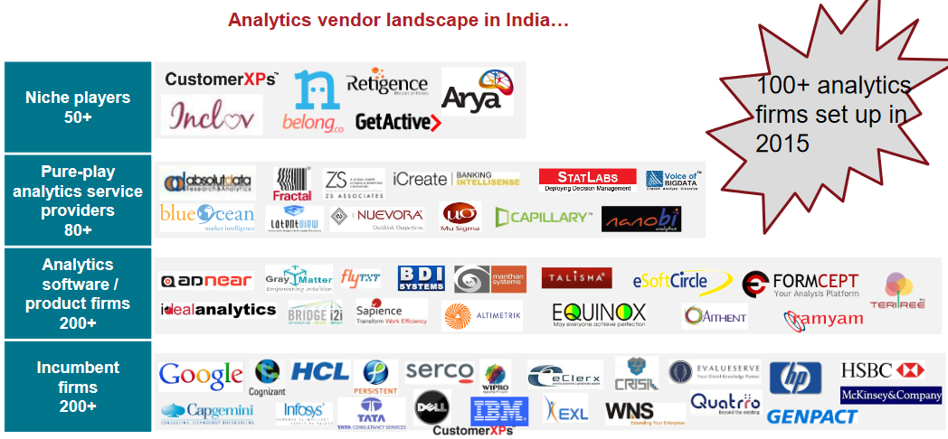
The India Analytics Industry (2016 NASSCOM data)

Slide 20
Part 3
Applications @ Work
Part 4
Q & A
15 minutes
15 minutes

Slide 21
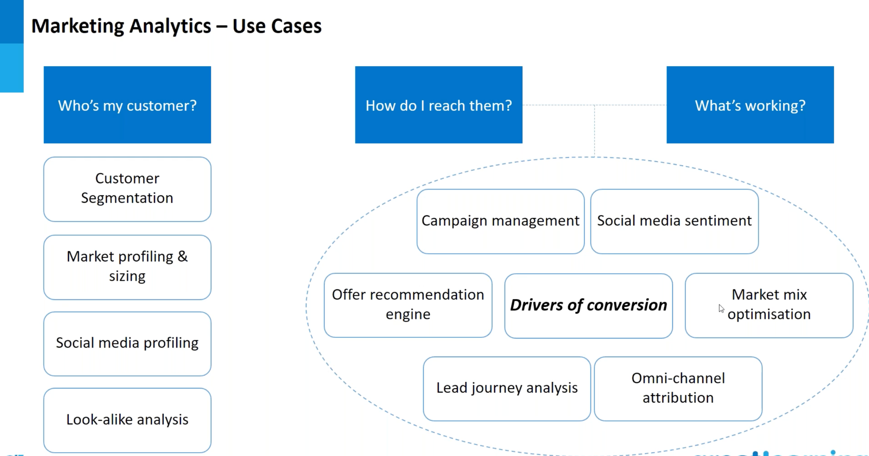

Slide 22
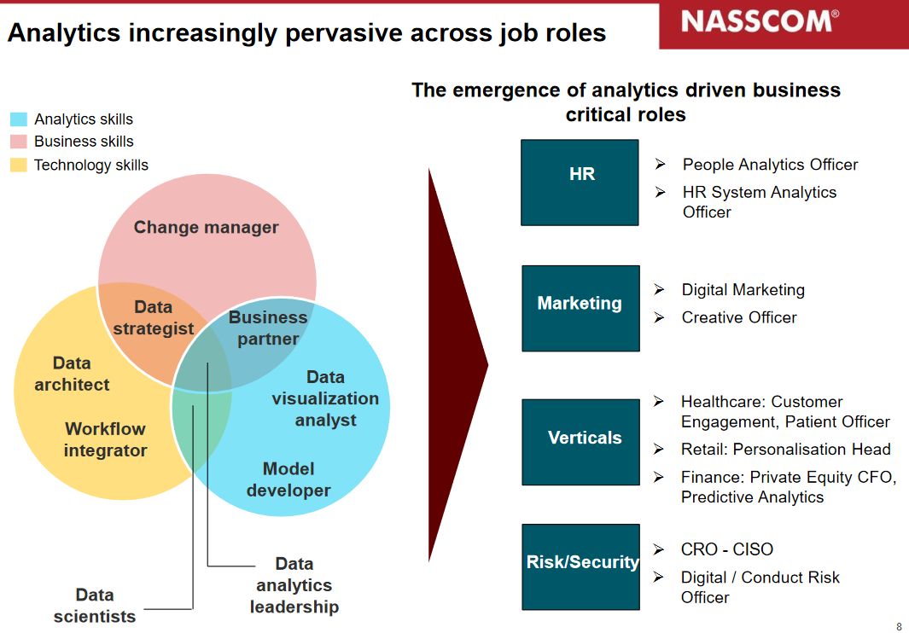
Industry Relevance of Analytics

Slide 23
Career Flowchart (not sensitive to experience levels)
Python Codes,
Viz. tools
Business Application of algorithms
Business Analytics Application Specialist
Competent
Competent
Expert
Expert
Salary
(non linear scale)
Other DS tools
SQL skills, Distributed computing,
Cloud computing (Azure, AWS)
Data warehousing
Building, deploying, maintaining ML algorithms,
Server management
Beginner
Competent
Expert
Data Scientist
Have personally witnessed cases on both sides of the story!

Slide 24
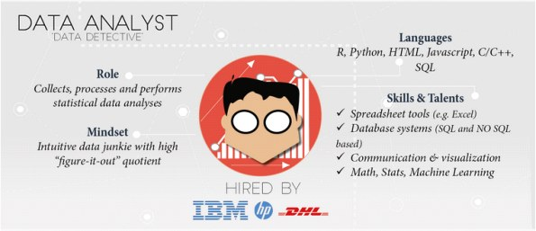
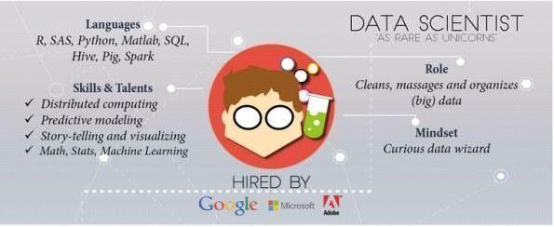
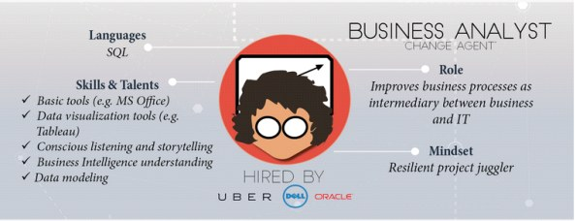
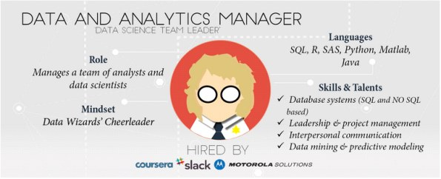
Typical Industry Designations

Slide 25
Business Case Studies

Slide 26
Retail Store Design

Slide 27
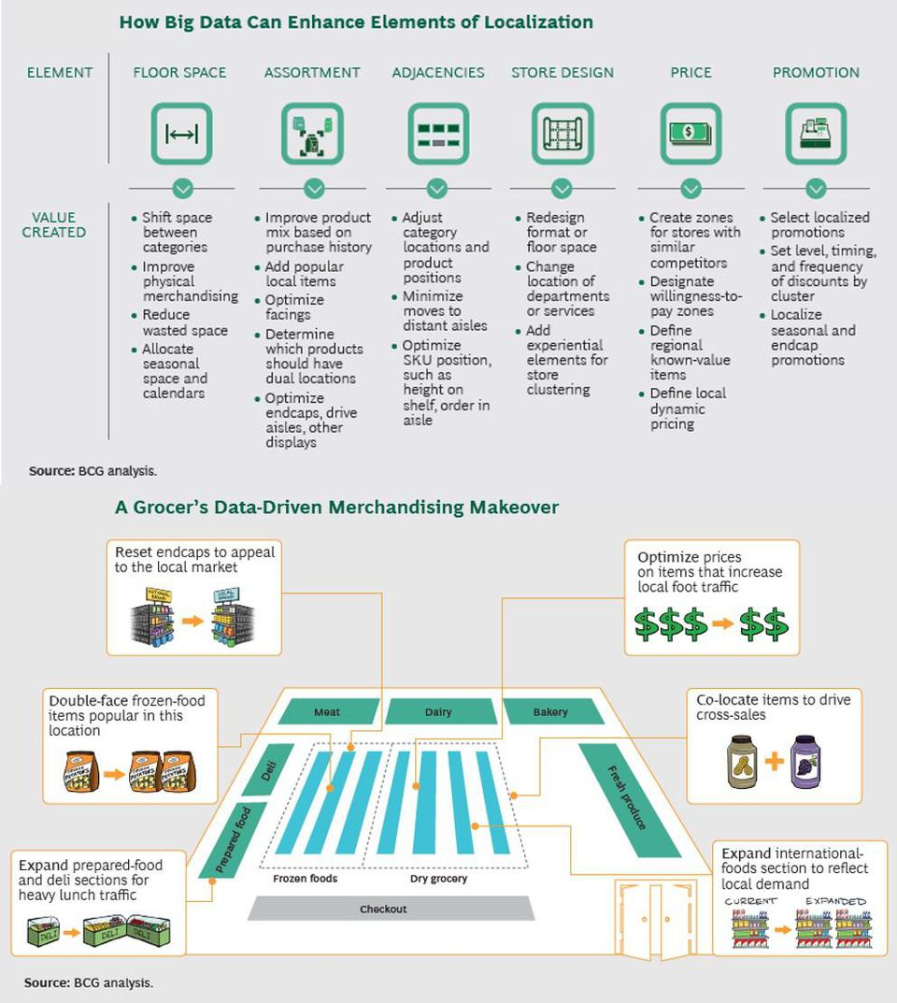

Slide 29
Wearable Gadgets

Slide 30
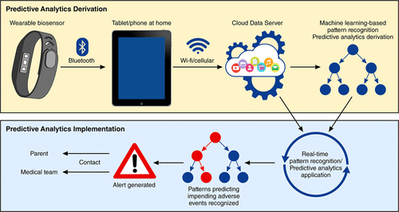
Healthcare Analytics – Wearable Gadgets

Slide 31
Finance, Marketing & HR

Slide 32
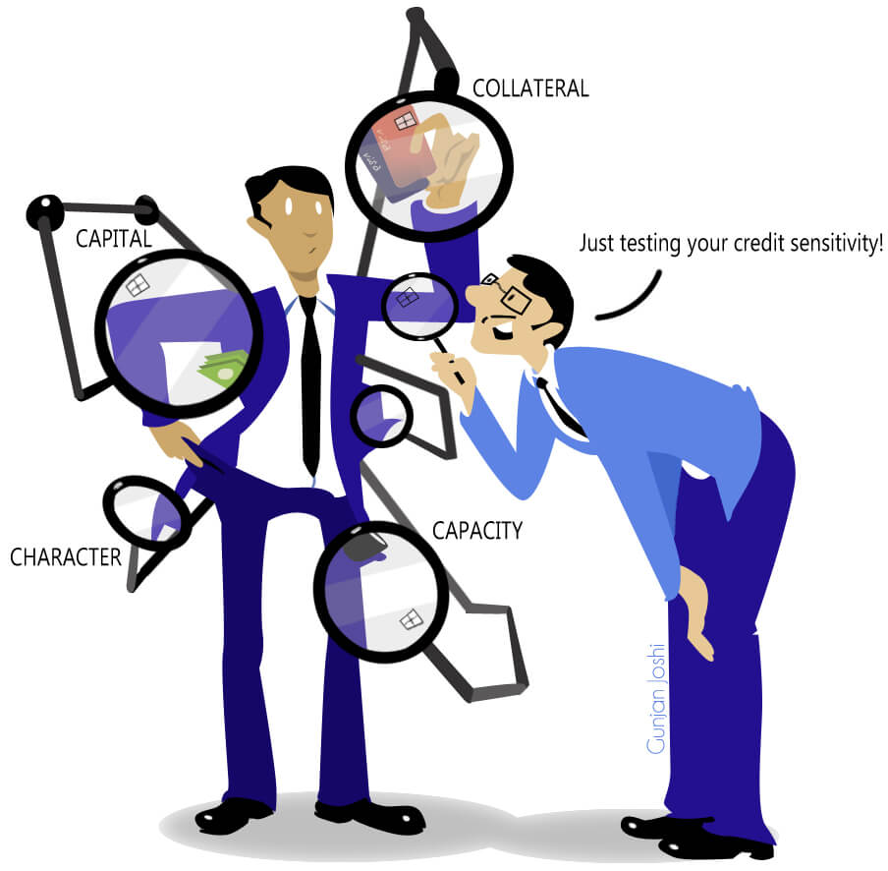
Credit Risk Analytics

Slide 33
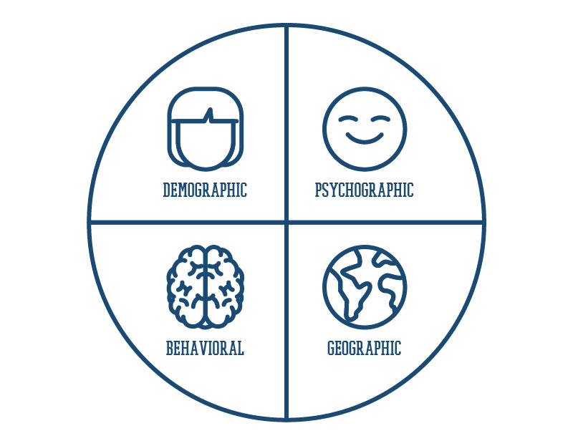
Market Segmentation
STP Analysis

Slide 34
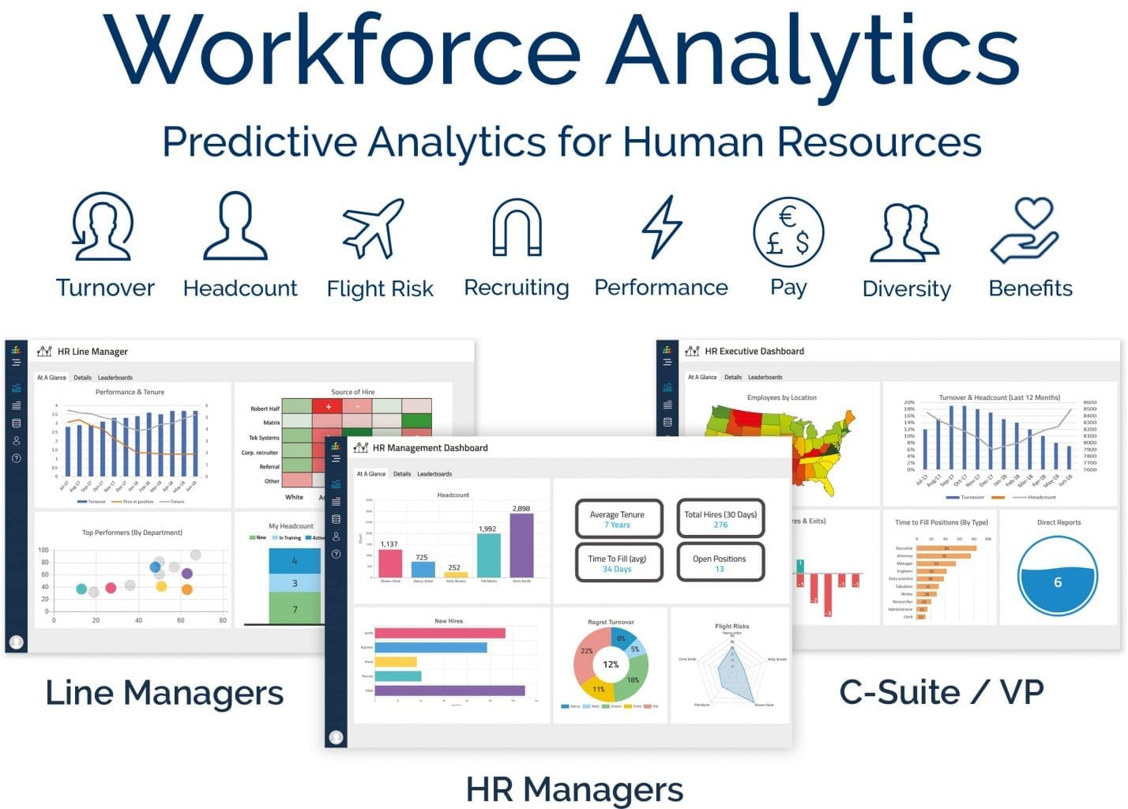

Slide 35
Power Sector

Slide 36
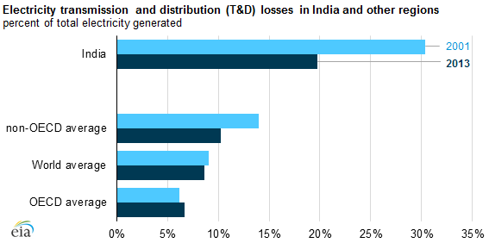
Source

Slide 37
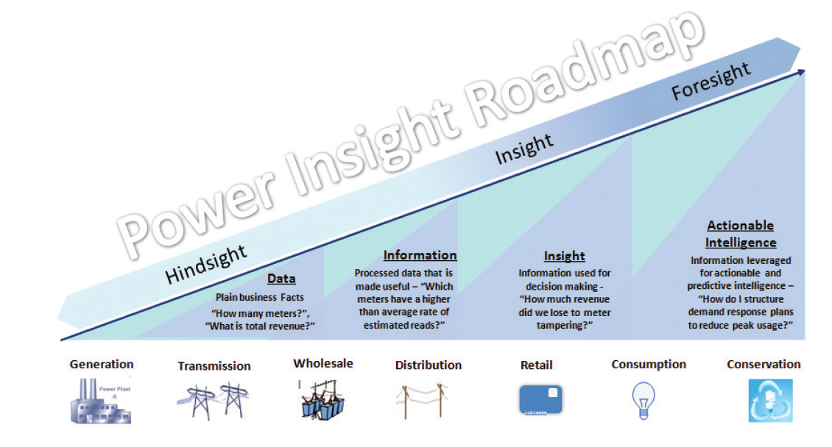

Slide 38
Part 1
Setting the Context
Part 2
The India Analytics Landscape
Part 3
Applications @ Work
Part 4
Q & A
15 minutes
30 minutes
45 minutes
30 minutes

Slide 39
Reference Material
Market research reports & articles in the public domain:
Analytics India Magazine + Analytix Labs, 2019-20 (link1, link2)
Modor Intelligence, 2020 (link, link2)
NASSCOM, 2016 (link)
Analytics Peepal, 2018 (link)
McKinsey, 2018 (link)
Forbes, 2018 (link)
Analytics Vidhya, 2020 (link)
Deloitte case study (link)

